Slide 1
4 ChatBots
By Mingjun Zha, Minh Bui, Yang Hu, Weixiang Zhang

Slide 2
Topic
Music - by Minh Bui
NBA - by Yang Hu
LOL - by Weixiang Zhang
Makeup - by Mingjun Zha
Sign in/up - by Weixiang & Minh
Chatbotview - by Mingjun & Minh
Client & server - by Minh
Test coding - by Mingjun & Minh & Weixiang & Yang
UML diagram - by Yang
Javadoc - by Mingjun

Slide 3
characterId
Music [!]
Makeup [*]
LoL [%]
NBA [#]

Slide 4
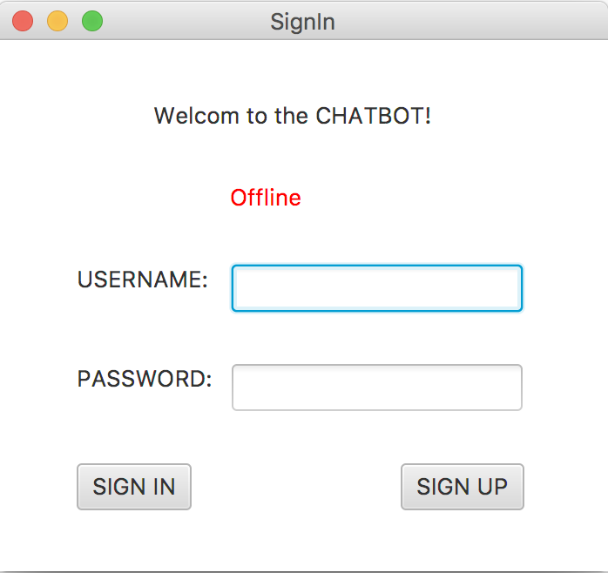
Sign in view without server connected

Slide 5
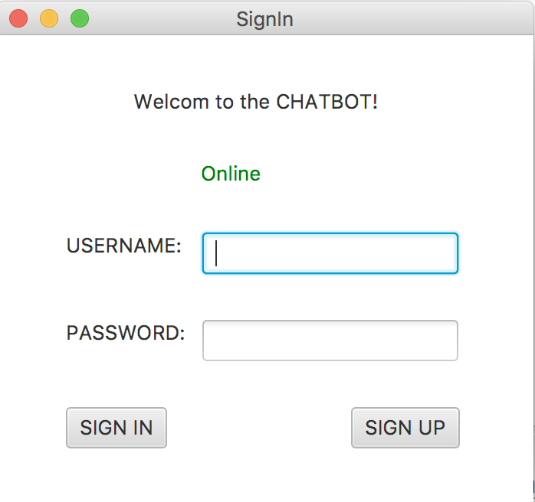
Connected to Server

Slide 6
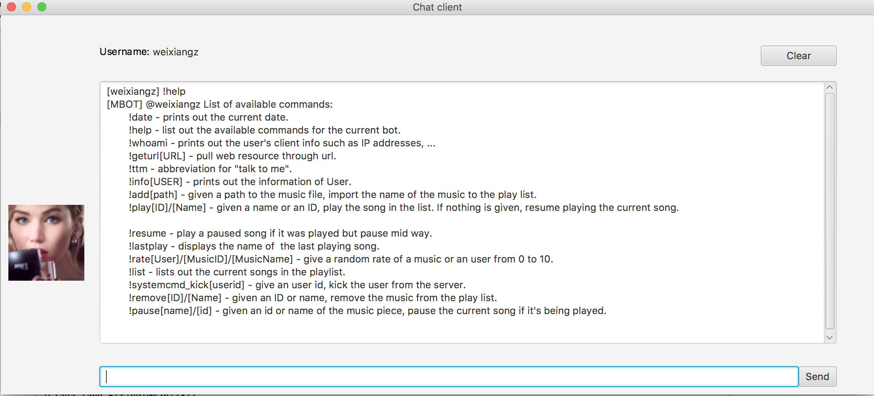
Help command example

Slide 7
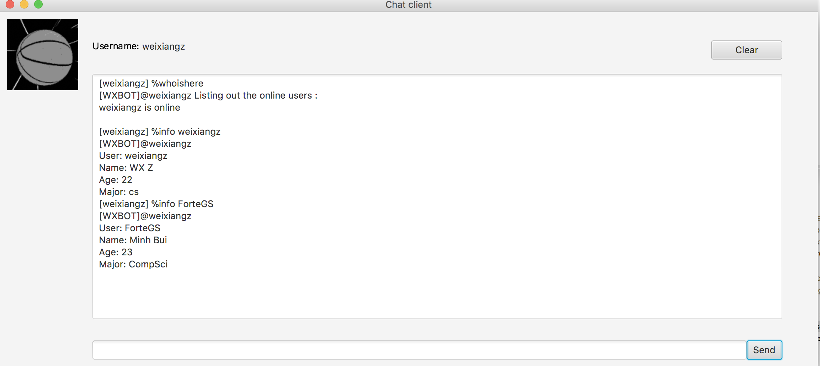
User information

Slide 8
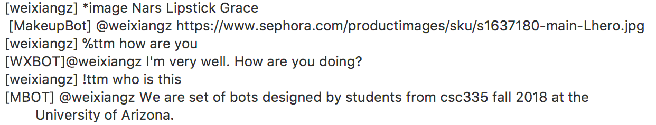
NLU response

Slide 9
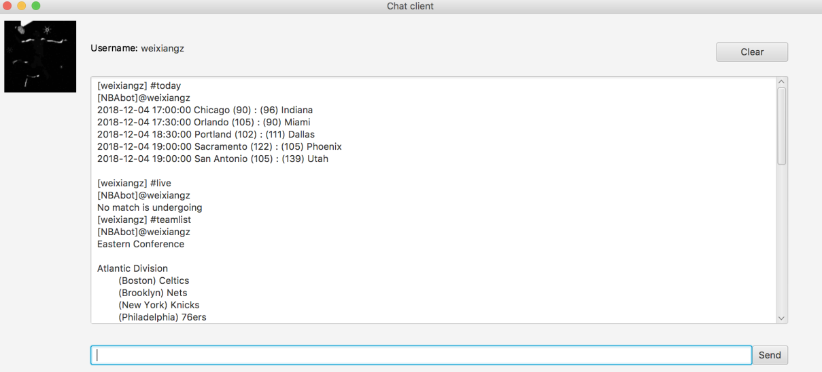
Web scraping

Slide 10
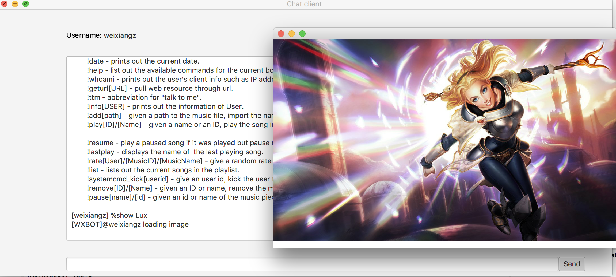
Live information from web resources

Slide 11
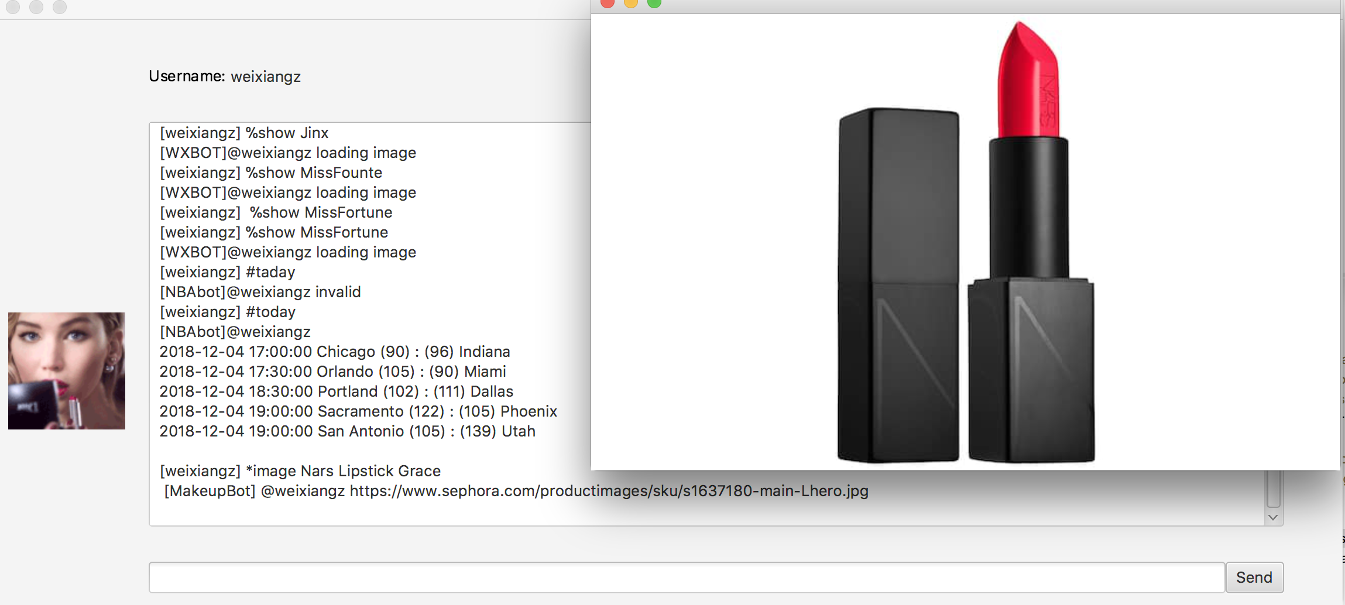

Slide 12
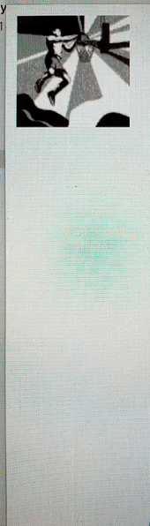
Animation

